Slide 1





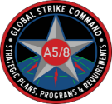





AFGSC B2C2WG
Directorates
A1
A2
A3
A4
Boards, Bureaus, Centers, Cells, and Working Groups
A5/8
A9
Special
Staff
Boards
Human Capital Board
Lethality & Readiness Board
Sustainment and Support Board
Modernization and Recapitalization Board
Innovation, Partnership, and Engagement Board
Financial Management Board
Striker Action Board

